Slide 1
Supplemental Compensation & Sponsored Awards at the University of Arizona
Tara Gonzales
Sponsored Projects & Contracting Services (SPCS)

Slide 2
Objectives
Increase understanding of supplemental compensation
Learn when supplemental compensation is an allowable cost on a sponsored award
Understand the basic employee eligibility requirements for supplemental compensation
Acquire tips for smooth routing and approval of supplemental compensation requests

Slide 3
What is Supplemental Compensation?
Institutional Base Salary (IBS)
The total annual cash compensation paid by the institution for an employee’s appointment for time spent performing teaching, research, service and administrative activities.
Supplemental Compensation
Compensation received from employment that is in addition to the regular, ordinary salary or wages.
The IBS consists of the regular assignment, additional jobs/titles and related components of pay.
Uniform Guidance definitions: §200.430 Compensation—personal services

Slide 4
When is Supp Comp Allowable Sponsored Awards?
Cost Allowability
Employee Eligibility

Slide 5
SPCS Reviews For:
Cost Allowability
Benefit to Project / Funding Plan
Account Status
Available Balance
Period of Performance
Hours, Dates, Supp Comp Calendar
Sponsor Limitations
NSF – 2 months
HHS/NIH Cap
Hourly Rate & Authorized Earnings
University Guidelines

Slide 6
Cost Allowability: Funding Plan
Funding plan to include
Account Numbers
Dates for each account
Hours for each account
Include information for entire supp comp period
Include in Supp Comp request
Attachment (preferred)
Approver comments
Job description

Slide 7
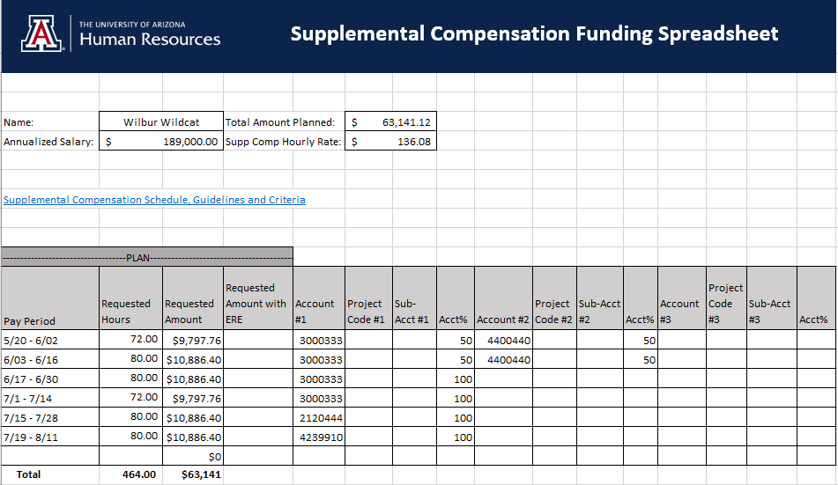

Slide 8
Cost Allowability: Authorized Earnings & Hourly Rate
Authorized Earnings Per Year
Fiscal - 1/12 of annualized salary (176 hours)
Academic - 1/3 of annualized salary (464 hours)
Supp Comp Hourly Rate Formula
Fiscal
Academic
Annualized salary / 2088
(2088 for FY21, may vary by FY)
Annualized salary * .00072

Slide 9
Cost Allowability: University Guidelines
Note: The 2021 Summer Schedule is forthcoming. The 2020 calendar is included as an example.

Slide 10
Cost Allowability: Sponsor Limitations
Department of Health & Human Services
Legislative Mandate restricts the amount of direct salary to Executive Level II of the Federal Executive pay scale
Effective January 3, 2021, the salary limitation for Executive Level II is $199,300
Equates to $107.62 per hour
Hourly amount over the cap can be cost shared
OR supp comp can be issued at cap rate of $107.62 per hour

Slide 11
Cost Allowability: Sponsor Limitations
National Science Foundation
2/9th (310 hours) annual salary limitation for senior personnel
May internally approve an increase to the project after award is made, even if in excess of two-month salary policy
Attach Investigator’s justification to supp comp request, must be project related justification
No formal NSF prior approval required if no change to objectives or scope
NSF prior approval is required if the objectives or scope changes

Slide 12
SPCS Reviews For:
Employee Eligibility
Employment Type
Appointment Period
Immigration Status
E-Verify
Faculty, Staff
Fiscal, Academic
International Faculty & Scholars Office
Previous Earned Supp Comp

Slide 13
Employee Eligibility: Employment Type & Appointment Period
Faculty / Appointed
Academic vs. Fiscal Appointments
University Staff
Graduate Associates

Slide 14
Faculty / Appointed

Slide 15
Faculty/Appointed: Is the payment outside of the appointment period?
Academic
Summer & Winter Break
464 hours total
Fiscal
N/A – Entire year is appointment period
Yes, Proceed
No, Proceed with caution

Slide 16
Faculty/Appointed: Payments within appointment period
Intra-Institution of Higher Education (IHE) consulting
Is assumed to be undertaken as an IHE obligation for faculty, requiring no compensation in addition to IBS
In unusual cases, charges for such work representing additional compensation above IBS are allowable provided that:
Consultation is across departmental lines or involves a separate or remote operation
The work performed by the faculty member is in addition to his or her regular responsibilities
Consulting arrangements are specifically provided for in the Federal award or approved in writing by the Federal awarding agency
Proceed with Caution

Slide 17
Faculty/Appointed: Payments within appointment period
When determined to be allowable, adhere to hour limitations
Fiscal
Max 176 hours per fiscal year
Academic
Counts towards 464 max hours allowable per Academic Year*
Note: Academic year is the academic year followed by summer (mid-August to mid-August)
Proceed with Caution

Slide 18
Faculty/Appointed: Payments within appointment period
If determined not allowable, consider alternatives
Change in effort allocation via Position Distribution
Change in FTE
Component of Pay
Proceed with Caution

Slide 19
University Staff

Slide 20
University Staff Supp Comp
Not allowed if an employee is budgeted or paid on the award as regular pay
Should not be used as a pay increase for increased workload or expanded responsibilities
The work should be in a different job classification/outside of duties/different line of work
Should be short term (2-3 pay periods)

Slide 21
Graduate Associates

Slide 22
Graduate Associate Supp Comp
Refer to Graduate Assistant/Associate Manual policy and Graduate College
SPCS does not review

Slide 23
Employee Eligibility
Visa Status
Citizen or Permanent Resident
Other statuses must be approved by International Faculty and Scholars Office
Attach approval to supp comp request
https://global.arizona.edu/international-faculty/immigration-services
UArizona has 90 calendar days after date of contract award or 30 days after assignment to the contract, whichever date is later
SPCS cannot approve unless compliant
E-Verify 52.222-54

Slide 24
Approve
Goal is to approve request in a timely manner, without needing to contact submitter for additional information or changes.

Slide 25
Routing Tips
Include funding plan with accounts, dates, and hours for entire supp comp period.
Ensure position distribution is updated; add notes if changes in process.
Use correct hourly rate (or cost share) for individuals over the salary cap.
Include authorization from International Faculty and Scholars Office when employee is not a US Citizen or Permanent Resident.
If request is within appointment period, include sufficient justification to document the work is outside of normal job duties, and is not Intra-Institution consulting.

Slide 26
Questions?
Tara Gonzales
Senior Manager, Financial Compliance Services
Sponsored Projects & Contracting Services
The University of Arizona
SPCS-financialcompliance@arizona.edu

